Slide 1
Data Mining Department of Energy Trading Company
Data Mining
Presented By: Md Monsur Ali(24547)

Slide 2
Agenda
Introduction
Question & Answer
Conclusion

Slide 3
Introduction
What is our work ?
About Dataset
K-means Clustering
Rstudio working

Slide 4
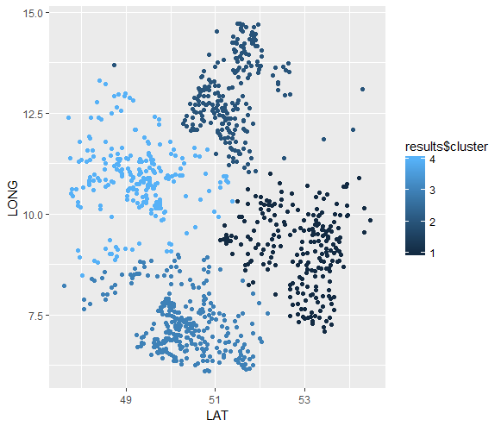
Question & Answer
Q1: To find regional differences
In this figure, X-axis show LAT, Y-axis shows LONG and dots are shown as customers. All dots are compared with four deafferents color and it indicate region differences.

Slide 5
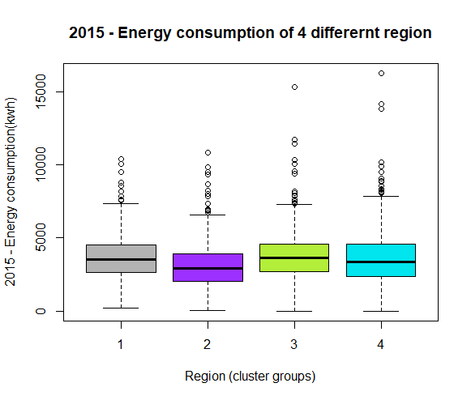
Question & Answer
Q2: Compare the energy consumption in the different regions, e.g. in 2015. Use a chart to illustrate you explanation.
In this boxplot chart, it is clearly shown that the number of one and three regions have almost same consumption than other two regions. Number four region is achieved the second position of consumption where number two region has the lowest consumption.

Slide 6
Question & Answer
Q3: Is the energy consumption of these long term customers rising or declining? Are there regional differences?
In 2010 and 2011, energy consumption was slightly decreasing in 2011 in every region but 2012 energy consumption was little increase. Between 2013 to 2016, energy consumption was continuously decreasing. But the interesting fact was that 2016-year energy consumption was decreasing surprisingly huge. In 2017, energy consumption was increasing.

Slide 7
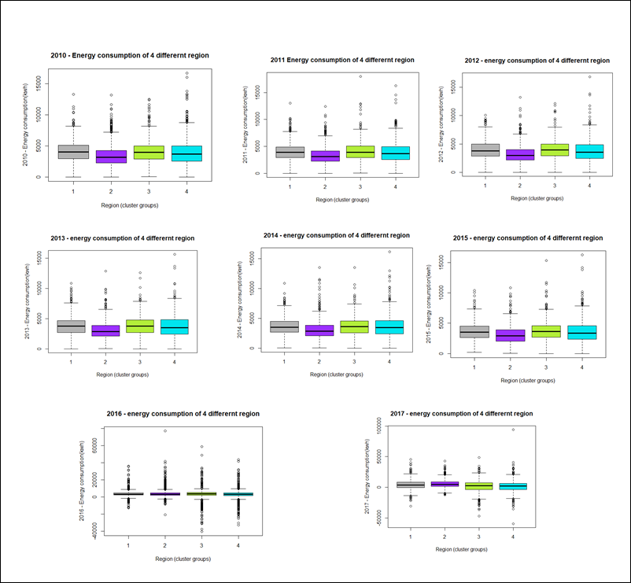
Question & Answer

Slide 8
Conclusion
Data mining is an important process to discover knowledge about customer behavior towards business offerings. It explores the unknown credible patterns those are significant for business success. The consumption of customers was decreasing almost every year and regional differences were also found. Procure department needs to buy less advance electricity for their customer.

Slide 9
THANK YOU

